Slide 1
Chapter 4 – Requirements Engineering
CS 425 October 15, 2024
Ian Sommerville,
Software Engineering, 10th Edition
Pearson Education, Addison-Wesley
Note: These are a slightly modified version of Chapter 4 slides available from the author’s site http://iansommerville.com/software-engineering-book/
Chapter 4 – Requirements Engineering

Slide 2
Topics covered
Functional and non-functional requirements
Requirements engineering processes
Requirements elicitation
Requirements specification
Requirements validation
Requirements change
Chapter 4 Requirements Engineering

Slide 3
Requirements engineering
The process of establishing the services that a customer requires from a system and the constraints under which it operates and is developed.
The system requirements are the descriptions of the system services and constraints that are generated during the requirements engineering process.
Translation – Figure out what a system needs to do, write it down.
Chapter 4 Requirements Engineering

Slide 4
What is a requirement?
Some function or characteristic that must exist in a project
It may range from a high-level abstract statement to an extremely detailed description of a function
Chapter 4 Requirements Engineering

Slide 5
Types of requirement
User requirements
Statements in natural language plus diagrams of the services the system provides and its operational constraints. Written for customers.
High level, easy to understand, potentially verbose
System requirements
A structured document setting out detailed descriptions of the system’s functions, services and operational constraints. Defines what should be implemented so may be part of a contract between client and contractor.
Lower level, more complex, quite detailed
Chapter 4 Requirements Engineering

Slide 6
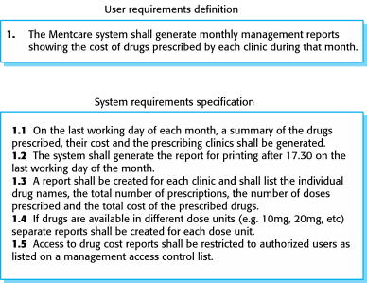
User and system requirements
Chapter 4 Requirements Engineering

Slide 7
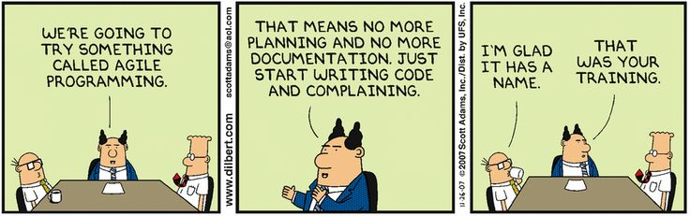
Agile methods and requirements
Many agile methods argue that producing detailed system requirements is a waste of time. Requirements change quickly, thus the requirements document is always out of date.
This is problematic for systems that require pre-delivery analysis or systems developed by several teams.
Chapter 4 Requirements Engineering

Slide 8
Functional and non-functional requirements
Chapter 4 Requirements Engineering

Slide 9
Functional and non-functional requirements
Functional requirements
Statements of services the system should provide, how the system should react to particular inputs and how the system should behave in particular situations (map directly to some code execution parts)
What the user sees, how they interact with the system, what the system does
May state what the system should not do
Non-functional requirements
Constraints on (or characteristics of) the services or functions offered by the system such as timing constraints, constraints on the development process, standards, etc.
Behind the scenes, inform functional requirements
Often apply to the system as a whole rather than individual features or services
Chapter 4 Requirements Engineering

Slide 10
Functional requirements
Describe functionality or system services
Dependent on the type of software, expected users and the type of system where the software is used
Functional user requirements may be high-level statements of what the system should do
Functional system requirements should describe the system services in detail
Chapter 4 Requirements Engineering

Slide 11
Requirements imprecision
Problems arise when functional requirements are not precisely stated
Ambiguous requirements may be interpreted in different ways by developers and users
Chapter 4 Requirements Engineering

Slide 12
Requirements completeness and consistency
In principle, requirements should be both complete and consistent
Complete
They should include descriptions of all functions required
Consistent
There should be no conflicts or contradictions in the descriptions of the system facilities
Chapter 4 Requirements Engineering

Slide 13
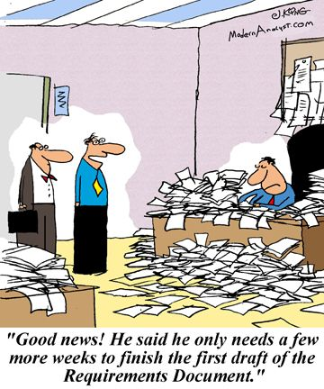
Requirements completeness and consistency
At what point does working towards completeness take away from the project?
Chapter 4 Requirements Engineering

Slide 14
Non-functional requirements
These define system properties and constraints e.g., reliability, response time, storage requirements, platform
Process requirements may also be specified mandating a particular IDE, programming language or development method
While functional requirements map directly to running code, non-functional requirements may be more critical than functional requirements. If these are not met, the system may be useless.
They may also force functional requirements. For instance a mobile application will require a touch based UI.
Chapter 4 Requirements Engineering

Slide 15
Non-functional requirements implementation
Non-functional requirements may affect the overall architecture of a system rather than the individual components
For example, to ensure that performance requirements are met, you may have to organize the system to minimize communications between components
Chapter 4 Requirements Engineering

Slide 16
Non-functional classifications
Product requirements
Requirements which specify that the delivered product must behave in a particular way, e.g. execution speed, or reliability
Organizational requirements
Requirements which are a consequence of organizational policies and procedures, e.g. process standards used or implementation requirements
External requirements
Requirements which arise from factors which are external to the system and its development process, e.g. interoperability requirements and legislative requirements
Chapter 4 Requirements Engineering

Slide 17
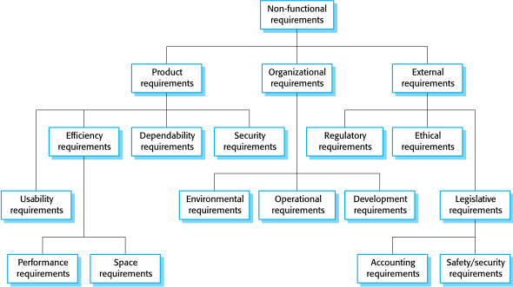
Non-functional classifications
Chapter 4 Requirements Engineering

Slide 18
Examples of nonfunctional requirements in the Mentcare system
Product requirement The Mentcare system shall be available to all clinics during normal working hours (Mon–Fri, 0830–17.30). Downtime within normal working hours shall not exceed five seconds in any one day. Organizational requirement Users of the Mentcare system shall authenticate themselves using their health authority identity card. (Some nonfunctional requirements inform the need for specific functional requirements) External requirement The system shall implement patient privacy provisions as set out in HStan-03-2006-priv.
Chapter 4 Requirements Engineering

Slide 19
Mentcare system: functional requirements
A user shall be able to search the appointments lists for all clinics.
The system shall generate each day, for each clinic, a list of patients who are expected to attend appointments that day.
Each staff member using the system shall be uniquely identified by his or her 8-digit employee number.
Chapter 4 Requirements Engineering

Slide 20
Metrics for specifying non-functional requirements
Property | Measure
Speed | Processed transactions/second User/event response time Screen refresh time
Size | Mbytes Number of ROM chips
Ease of use | Training time Number of help frames
Reliability | Mean time to failure Probability of unavailability Rate of failure occurrence Availability
Robustness | Time to restart after failure Percentage of events causing failure Probability of data corruption on failure
Portability | Percentage of target dependent statements Number of target systems
Chapter 4 Requirements Engineering

Slide 21
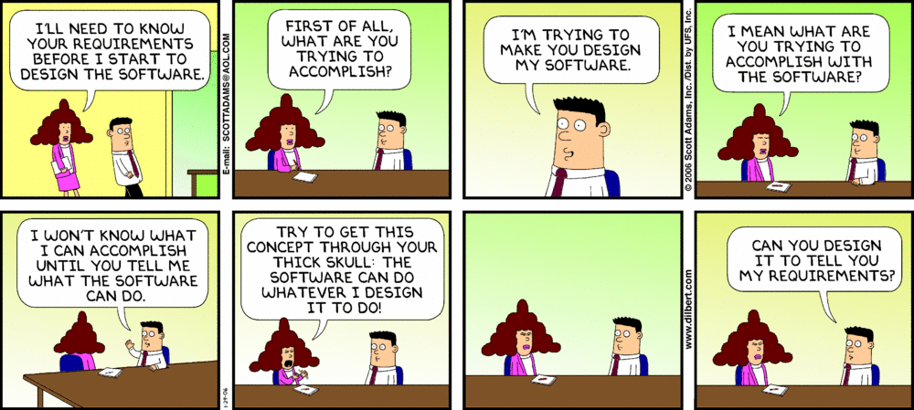
Requirements elicitation
Chapter 4 Requirements Engineering

Slide 22
Requirements elicitation and analysis
Sometimes called requirements elicitation or requirements discovery
Involves technical staff working with customers to find out about the application domain, the services that the system should provide and the system’s operational constraints.
May involve end-users, managers, engineers involved in maintenance, domain experts, trade unions, and other. These are called stakeholders.
Find requirements!
Chapter 4 Requirements Engineering

Slide 23
Requirements elicitation
Software engineers work with a range of system stakeholders to find out about the application domain, the services that the system should provide, the required system performance, hardware constraints, other systems.
Stages include:
Requirements discovery
Requirements classification and organization
Requirements prioritization and negotiation
Requirements specification
Chapter 4 Requirements Engineering

Slide 24
Problems of requirements elicitation
Stakeholders don’t know what they really want
Stakeholders express requirements in their own terms
Different stakeholders may have conflicting requirements
Organizational and political factors may influence the system requirements
The requirements change during the analysis process. New stakeholders may emerge and the business environment may change.
Chapter 4 Requirements Engineering

Slide 25
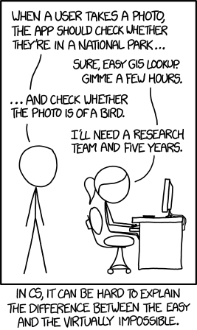
Problems of requirements elicitation
Reality versus Perception
Customer may not understand why a computer can’t do what a child can
Chapter 4 Requirements Engineering

Slide 26
Requirements discovery - Interviewing
Formal or informal interviews with stakeholders are part of most RE processes
Types of interview
Closed interviews based on pre-determined list of questions
Open interviews where various issues are explored with stakeholders
Effective interviewing
Be open-minded, avoid pre-conceived ideas about the requirements and be willing to listen to stakeholders
Prompt the interviewee to get discussions going using a springboard question, a requirements proposal, or by working together on a prototype system
Chapter 4 Requirements Engineering

Slide 27
Problems with interviews
Application specialists may use language to describe their work that isn’t easy for the requirements engineer to understand.
Every profession has its own language
Interviews are not good for understanding domain requirements
Requirements engineers cannot understand specific domain terminology (see above)
Some domain knowledge is so familiar that people find it hard to articulate or think that it isn’t worth articulating
The odd case that is unlikely to come up in an interview
Chapter 4 Requirements Engineering

Slide 28
Requirements discovery - Ethnography
A social scientist spends a considerable time observing and analyzing how people actually work
People do not have to explain or articulate their work
Social and organizational factors of importance may be observed
Ethnographic studies have shown that work is usually richer and more complex than suggested by simple system models
Time consuming
Chapter 4 Requirements Engineering

Slide 29
Stories and scenarios
Scenarios and user stories are real-life examples of how a system can be used
Stories and scenarios are a description of how a system may be used for a particular task
Because they are based on a practical situations, stakeholders can relate to them and can comment on their situation with respect to the story.
Chapter 4 Requirements Engineering

Slide 30
Scenarios
A structured form of user story
Scenarios should include
A description of the starting situation
A description of the normal flow of events
A description of what can go wrong
Information about other concurrent activities
A description of the state when the scenario finishes
Chapter 4 Requirements Engineering

Slide 31
Requirements specification
Chapter 4 Requirements Engineering

Slide 32
Requirements specification
The process of writing down the user and system requirements in a requirements document
User requirements must be understandable by end-users and customers who do not have a technical background
System requirements are more detailed requirements and may include more technical information
The requirements may be part of a contract for the system development
It is therefore important that these are as complete as possible
Chapter 4 Requirements Engineering

Slide 33
Ways of writing a system requirements specification
Notation | Description
Natural language | The requirements are written using numbered sentences in natural language. Each sentence should express one requirement.
Structured natural language | The requirements are written in natural language on a standard form or template. Each field provides information about an aspect of the requirement.
Design description languages | This approach uses a language like a programming language, but with more abstract features to specify the requirements by defining an operational model of the system. This approach is now rarely used although it can be useful for interface specifications. (almost pseudocode)
Graphical notations | Graphical models, supplemented by text annotations, are used to define the functional requirements for the system; UML use case and sequence diagrams are commonly used.
Mathematical specifications | These notations are based on mathematical concepts such as finite-state machines or sets. Although these unambiguous specifications can reduce the ambiguity in a requirements document, most customers don’t understand a formal specification. They cannot check that it represents what they want and are reluctant to accept it as a system contract
Chapter 4 Requirements Engineering

Slide 34
Requirements and design
In principle, requirements should state what the system should do and the design should describe how it does this
In practice, requirements and design are inseparable
A system architecture may be designed to structure the requirements
The system may inter-operate with other systems that generate design requirements
The use of a specific architecture to satisfy non-functional requirements may be a domain requirement
This may be the consequence of a regulatory requirement
Chapter 4 Requirements Engineering

Slide 35
Natural language specification
Requirements are written as natural language sentences supplemented by diagrams and tables
Used for writing requirements because it is expressive, intuitive and universal. This means that the requirements can be understood by users and customers.
Chapter 4 Requirements Engineering

Slide 36
Problems with natural language
Lack of clarity
Precision is difficult without making the document difficult to read
Requirements confusion
Functional and non-functional requirements tend to be mixed-up
Requirements amalgamation
Several different requirements may be expressed together
Chapter 4 Requirements Engineering

Slide 37
Use cases
Use-cases are a kind of scenarios included in UML
Use cases identify the actors in an interaction and which describe the interaction itself
A set of use cases should describe all possible interactions with the system
High-level graphical models supplemented by more detailed tabular description (see Chapter 5)
UML sequence diagrams may be used to add detail to use-cases by showing the sequence of event processing in the system
Chapter 4 Requirements Engineering

Slide 38
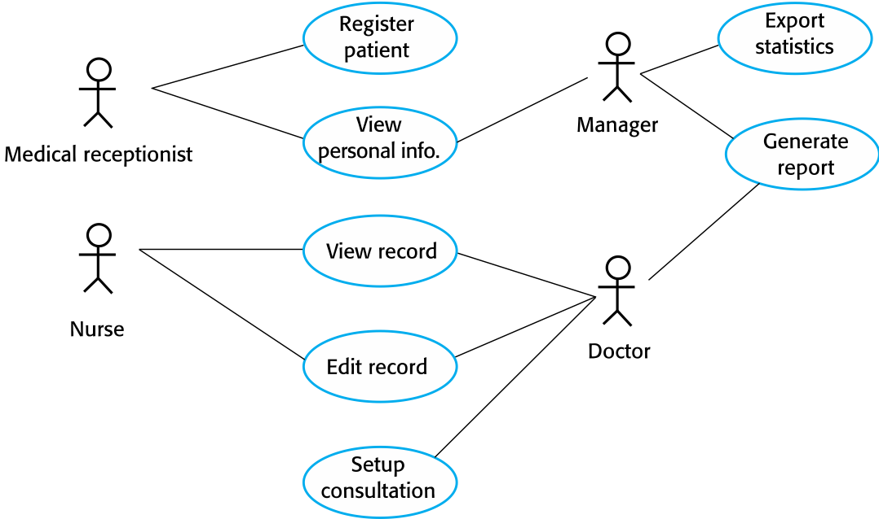
Use cases for the Mentcare system
Chapter 4 Requirements Engineering

Slide 39
The software requirements document
The software requirements document is the official statement of what is required of the system developers
Should include both a definition of user requirements and a specification of the system requirements
It is NOT a design document. As far as possible, it should set of WHAT the system should do rather than HOW it should do it.
See general structure of a “req spec” document next, but note that we use a “streamlined” version in Project Part #2
Chapter 4 Requirements Engineering

Slide 40
The structure of a requirements document
Chapter | Description
Preface | This should define the expected readership of the document and describe its version history, including a rationale for the creation of a new version and a summary of the changes made in each version.
Introduction | This should describe the need for the system. It should briefly describe the system’s functions and explain how it will work with other systems. It should also describe how the system fits into the overall business or strategic objectives of the organization commissioning the software.
Glossary | This should define the technical terms used in the document. You should not make assumptions about the experience or expertise of the reader.
User requirements definition | Here, you describe the services provided for the user. The nonfunctional system requirements should also be described in this section. This description may use natural language, diagrams, or other notations that are understandable to customers. Product and process standards that must be followed should be specified.
System architecture | This chapter should present a high-level overview of the anticipated system architecture, showing the distribution of functions across system modules. Architectural components that are reused should be highlighted.
Chapter 4 Requirements Engineering

Slide 41
The structure of a requirements document
Chapter | Description
System requirements specification | This should describe the functional and nonfunctional requirements in more detail. If necessary, further detail may also be added to the nonfunctional requirements. Interfaces to other systems may be defined.
System models | This might include graphical system models showing the relationships between the system components and the system and its environment. Examples of possible models are object models, data-flow models, or semantic data models.
System evolution | This should describe the fundamental assumptions on which the system is based, and any anticipated changes due to hardware evolution, changing user needs, and so on. This section is useful for system designers as it may help them avoid design decisions that would constrain likely future changes to the system.
Appendices | These should provide detailed, specific information that is related to the application being developed; for example, hardware and database descriptions. Hardware requirements define the minimal and optimal configurations for the system. Database requirements define the logical organization of the data used by the system and the relationships between data.
Index | Several indexes to the document may be included. As well as a normal alphabetic index, there may be an index of diagrams, an index of functions, and so on.
Chapter 4 Requirements Engineering

Slide 42
Requirements validation
Chapter 4 Requirements Engineering

Slide 43
Requirements validation
Concerned with demonstrating that the requirements define the system that the customer really wants
Requirements error costs are high so validation is very important
Fixing a requirements error after delivery may cost up to 100 times the cost of fixing an implementation error
Chapter 4 Requirements Engineering

Slide 44
Requirements checking
Validity. Does the system provide the functions which best support the customer’s needs?
Consistency. Are there any requirements conflicts?
Completeness. Are all functions required by the customer included?
Realism. Can the requirements be implemented given available budget and technology
Verifiability. Can the requirements be checked?
Chapter 4 Requirements Engineering

Slide 45
Requirements change
Chapter 4 Requirements Engineering

Slide 46
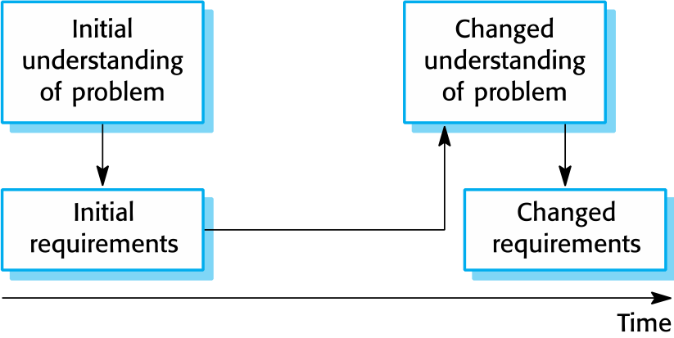
Requirements evolution
Chapter 4 Requirements Engineering

Slide 47
Requirements management
Requirements management is the process of managing changing requirements during the requirements engineering process and system development
New requirements emerge as a system is being developed and after it has gone into use
You need to keep track of individual requirements and maintain links between dependent requirements so that you can assess the impact of requirements changes. You need to establish a formal process for making change proposals and linking these to system requirements.
Chapter 4 Requirements Engineering

Slide 48
Key points
Requirements for a software system set out what the system should do and define constraints on its operation and implementation
Functional requirements are statements of the services that the system must provide or are descriptions of how some computations must be carried out
Non-functional requirements often constrain the system being developed and the development process being used
They often relate to the emergent properties of the system and therefore apply to the system as a whole
Chapter 4 Requirements Engineering

Slide 49
Key points
The requirements engineering process is an iterative process that includes requirements elicitation, specification, and validation
You can use a range of techniques for requirements elicitation including interviews and ethnography. User stories and scenarios may be used to facilitate discussions.
Requirements specification is the process of formally documenting the user and system requirements and creating a software requirements document
Chapter 4 Requirements Engineering

Slide 50
Key points
The software requirements document is an agreed statement of the system requirements. It should be organized so that both system customers and software developers can use it.
Requirements validation is the process of checking the requirements for validity, consistency, completeness, realism and verifiability
Business, organizational and technical changes inevitably lead to changes to the requirements for a software system. Requirements management is the process of managing and controlling these changes.
Chapter 4 Requirements Engineering

